Slide 1
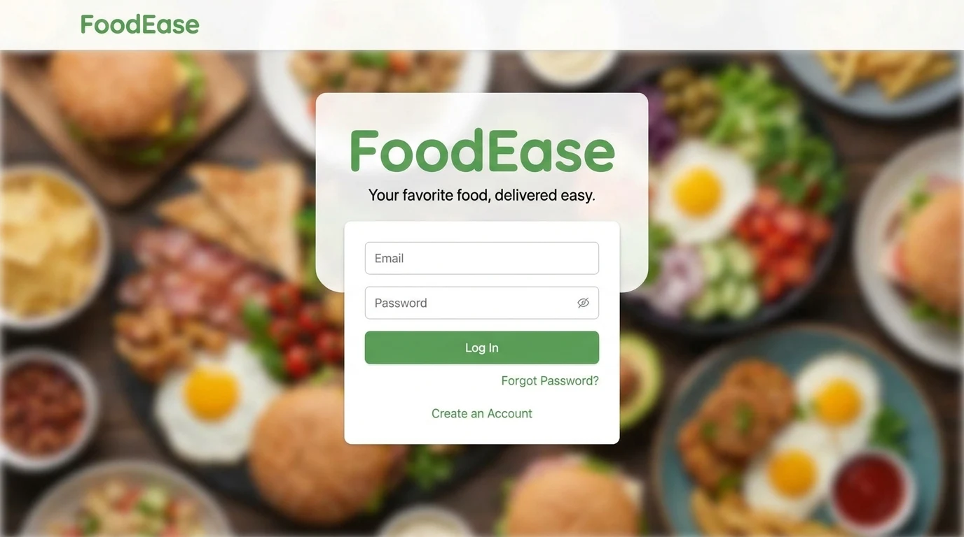


Slide 2















FoodEase
Home
Deals
Restaurants ▾
Log in
Order Now
Featured Categories
FoodEase
Home
Menu
Deals
Restaurants ▾
Cart (5)
Log in
Order Now
Pizza
Burgers
Sushi
Desserts
Healthy
FoodEase
Popular Restaurants
Search biryani, karahi, restaurants...
Order Now
Cheezious
Ginsoy
Bundu Khan
★★★★★
★★★★★
★★★★★
Delivery · 30 min
Delivery · 25 min
Delivery · 35 min
Savour Foods
Butt Karahi
Karachi Broast
★★★★★
★★★★★
★★★★★
Delivery · 30 min
Delivery · 40 min
Delivery · 25 min
Special Offers
Featured Categories
Get 50% OFF
Family Combo
50%
OFF
Discount code: FOODEASE50
Order Now
Pizza
Burgers
Sushi
Desserts
Healthy
About Us
Contact
Terms
About Us
FAQ
Site Map
Contact
Support
Contact Us
Privacy
Cookies
© 2026 FoodEase. All rights reserved.

Slide 3
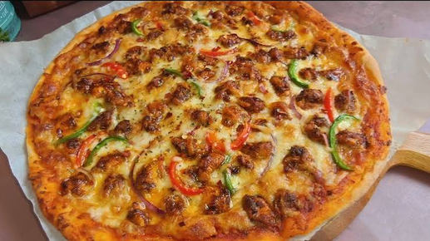
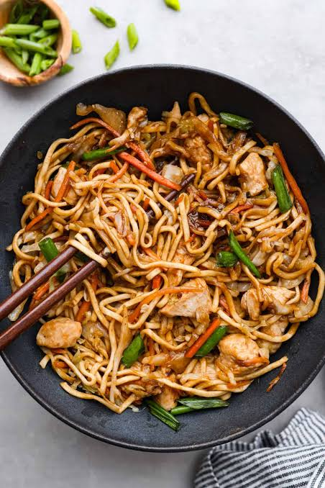
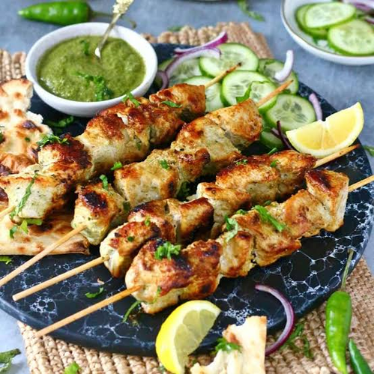
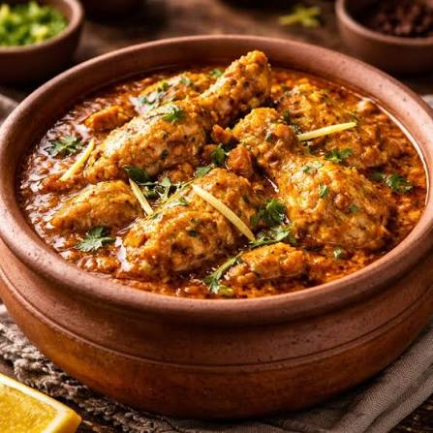
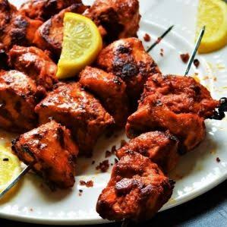
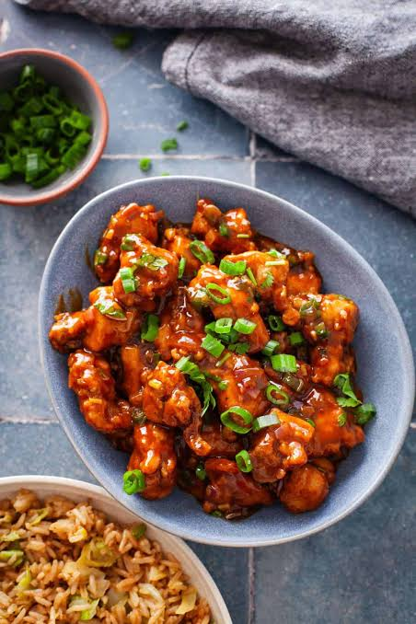
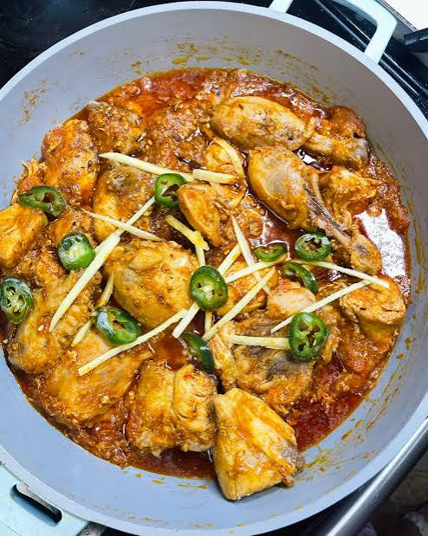
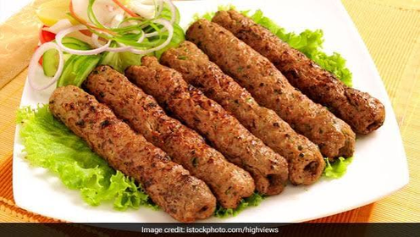
FoodEase
Order Now
FoodEase
Home
Home
Menu
Deals
Restaurants ▾
Log in
Order Now
Menu
Deals
Restaurants ▾
Cart (5)
Log in
Our Menu
Search dishes, e.g. biryani, karahi...
Fresh, desi flavours delivered to your door
All
Pizza
BBQ & Grill
Karahi
Chinese
Burgers
Desserts
Drinks
Bestseller
Popular
Chicken Tikka Pizza
Chicken Chowmein
Malai Boti
Chicken Handi
Medium, crown crust, tikka chunks
Wok-tossed noodles with chicken
Creamy boti grilled over charcoal
Slow-cooked in rich desi masala
Rs. 1,250
+ Add
Rs. 620
+ Add
Rs. 850
+ Add
Rs. 1,350
+ Add
Tikka Boti Platter
Chicken Manchurian
Chicken Karahi (Half)
Chicken Seekh Kebab
With salad and raita
Crispy, sweet and sour sauce
Tomato-based, with fresh ginger
6 pcs, with chutney and naan
Rs. 990
+ Add
Rs. 780
+ Add
Rs. 1,450
+ Add
Rs. 790
+ Add

Slide 4




FoodEase
Order Now
FoodEase
Home
Menu
Deals
Restaurants ▾
Cart (5)
Log in
Order Now
Home
Menu
Deals
Restaurants ▾
Cart (5)
Log in
Your Cart
5 items ready for checkout
Chicken Tikka Pizza
Order Summary
Medium, crown crust, tikka chunks
−
1
+
Rs. 1,250
✕
Rs. 1,250 each
Subtotal (5 items)
Rs. 4,560
Delivery fee
Rs. 150
Malai Boti
Discount
− Rs. 0
Creamy boti grilled over charcoal
−
2
+
Rs. 1,700
✕
Rs. 850 each
Enter promo code
Apply
Chicken Chowmein
Total
Rs. 4,710
Wok-tossed noodles with chicken
−
1
+
Rs. 620
✕
Rs. 620 each
Proceed to Checkout
Tikka Boti Platter
Estimated delivery: 30–40 min
With salad and raita
−
1
+
Rs. 990
✕
Rs. 990 each
Cash on delivery and online payment available
Secure checkout
← Continue Ordering

Slide 5
FoodEase
Home
Menu
Deals
Restaurants ▾
Cart (5)
Log in
Order Now
Checkout
✓
Cart
2
Checkout
3
Confirmation
Delivery Address
Order Summary
Full Name *
Phone Number *
e.g. Ahmed Khan
03XX XXXXXXX
1× Chicken Tikka Pizza
Rs. 1,250
City *
Area / Town *
2× Malai Boti
Rs. 1,700
Select your city
▾
e.g. Gulberg, DHA, Satellite Town
1× Chicken Chowmein
Rs. 620
1× Tikka Boti Platter
Rs. 990
Complete Address *
House / Flat no., Street, Block, Landmark
Subtotal
Rs. 4,560
Save address as
Delivery fee
Rs. 150
Home
Office
Other
+ Add delivery instructions
Discount
− Rs. 0
Payment Method
Total
Rs. 4,710
Cash on Delivery
Credit / Debit Card
Place Order
Pay in cash when your order arrives
Visa, Mastercard
JazzCash
Easypaisa
Estimated delivery: 30–40 min
Pay with your mobile wallet
Pay with your mobile wallet
By placing your order, you agree to our
You will pay Rs. 4,710 in cash to the rider on delivery. Please keep exact change ready.
Terms & Conditions and Privacy Policy
← Back to Cart

